Slide 1
Presentation Delivery
Davon Washington
Solution Seekers, Inc.
Notes:
Give introductions while the title slide is displayed
Ask some of these questions to get the audience warmed up and talking with you:
Do you like to make presentations?
Do you get nervous when you make a presentation?
What is the most difficult part in getting ready to present?
What is the most difficult part of actually presenting?
Do you have a good sense of humor?
When should you answer audience questions?

Slide 2


Be Prepared Personally
Dress appropriately
Be there early, get set up, and test equipment
Respect your audience
Be professional
You get only one chance to make a first impression!
Notes:
Never underestimate the importance of a first impression
If possible, welcome people as they arrive for your presentation

Slide 3
Give a Strong Opening
Answer . . .
“Why are we here?”
Notes:
Consider showing an agenda or a topic list
Relate why these topics are important for the audience

Slide 4
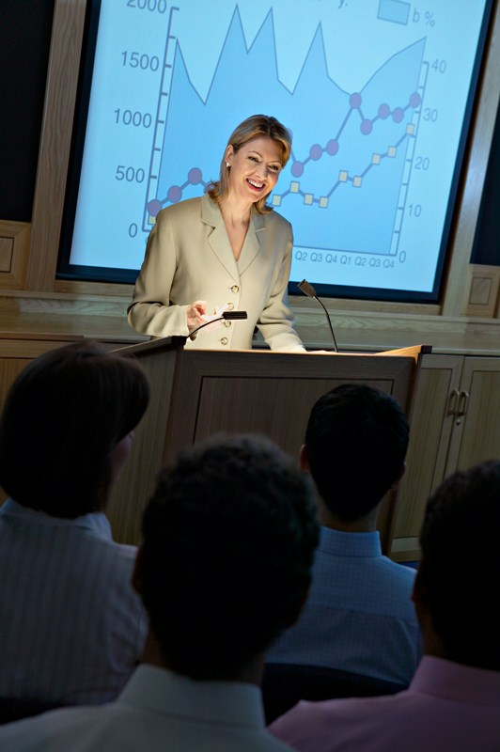

Show Good Body Language
Posture
Gestures
Eye Contact
Confidence
Energy
Enthusiasm
Smile
Notes:
Body language expresses your thoughts and attitudes
Posture—
Maintain an upright yet relaxed posture
Avoid leaning forward
Gestures—
Be natural and move around
Avoid gestures that could be offensive
Eye contact—
Look at people throughout the room
Do not read notes during the presentation
Never read from a script
Show confidence—
Don’t hide behind the podium
Smile
Be energetic but not over-bearing
Let your enthusiasm show . . . and smile

Slide 5


Control Nervous Mannerisms
It is normal
Harness the energy
Practice
Breath
Speak clearly
Notes:
It is normal to be nervous
This shows that you care
Being nervous can give you added energy
Practice will help you gain the ability to control your nervousness
Take deep breaths
Make a conscious effort to speak clearly
Don’t rush
Avoid fillers such as “uh” or “you know”
Get control. Make your “butterflies” fly in formation.

Slide 6

Handle Equipment Skillfully
Face the audience
Keep computer screen visible
Avoid watching the large screen
Use a remote control to advance slides
Use a laser pointer
Keep speaker notes available
Notes:
Face the audience
Talk to the audience and not the screen
Position your computer screen so you can see it without obviously glancing at it
Avoid watching the large screen
Use a remote control to advance slides
Use a laser pointer—sparingly
Learn to point without extending your arm
Help the audience find a particular concept on the slide
Keep speaker notes available—as a “memory jogger”
Or use Presenter View

Slide 7

Control Vocal Delivery
Explain—don’t read
Speak clearly
Avoid slang and jargon
Avoid verbal fillers
Be concise and don’t rush
Avoid monotone
Project your voice
Notes:
Speak with conviction so people know that you believe in your material
Explain . . . do not read what is on the screen
Speak clearly . . . and confidently
Avoid slang and jargon
Avoid verbal fillers such as “uh” or “you know”
Be concise and don’t rush
Give the audience time to absorb each point
Avoid monotone
Vary tone and pitch to emphasize words or phrases
Project your voice
Make sure people at the back of the room can hear you
Be aware of equipment noises

Slide 8

Encourage Audience Interaction
Build rapport with your audience
Encourage the audience to ask questions
Avoid arguments
Notes:
Build rapport with your audience
Give practical examples so your audience can relate to them
Get the audience involved by asking questions
Encourage the audience to ask questions
Restate a question from the audience so everyone will hear the question and your response
Answer questions thoughtfully
Always be respectful
Avoid arguments . . . offer to discuss issues after the presentation
If you can’t answer a question, that’s OK
Offer to research and get back to the person later
Ask for suggestions from the audience
Suggest other sources for information about the issue

Slide 9

Use Humor
Be careful
Humor must be natural
Use personal experiences
Notes:
Be careful with how you use humor
Use humor only if it is appropriate
Avoid jokes—you could unintentionally offend someone
Humor works best when it fits the presentation and seems natural
Break the ice
Be yourself; be real
Make your audience feel comfortable
Choose stories or examples from your own experience

Slide 10


Use Time Effectively
Stay within the allotted time
Use clock or watch
Ask for 5- or 10-minute warning
End on time (early is better)
Notes:
Plan your schedule in advance
Allow time for questions and discussion
Practice your timing
Stay within the allotted time
Use clock or watch during the presentation
Ask for 5- or 10-minute warning
End on time (early is better)

Slide 11
Give a Strong Close
Make it memorable
Notes:
Possibilities?
Summary statement
Restate key benefits
Motivating statement or quote
Action approaches?
Present a challenge
Review how to get started
Get commitment for action

Slide 12
Begin Promptly
Involve Your Audience
Maintain Eye Contact
Speak Clearly
Success!
Be Confident
Notes:
Make any “wrap up” comments and announcements

